Slide 1
Carbon Literacy Certificate Training
Module Four

Slide 2
Summary of Module 3:
Please watch this short video to refresh your knowledge:
Click Here
https://www.bbc.co.uk/programmes/p076w7g5

Slide 3
Climate Action

Slide 4
What you will learn in this section:
Why climate action matters
What the benefits of taking climate action are.
What climate action is taking place internationally, nationally and locally.
What action is needed to reduce carbon emissions to avoid the most damaging effects of climate change.

Slide 5
Solutions to Climate Change
Before continuing with this section, we encourage you to click on the below link to look at solutions to Climate Change:
Rank the solutions exercise
Please click here
Quiz: Climate change solutions - CNN.com - CNN.com

Slide 6
Why taking action to fight Climate Change matters
Please click to watch this short video:
https://youtu.be/oSqmCNNV2dQ

Slide 7
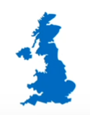
Why taking climate action matters
For the country:
More biodiversity, clean water and more green space to enjoy.
Reduce global warming, avoiding climate damages like flooding.
For the individual:
Quiet streets cleaner, air, less congestion, smarter cities and more comfortable homes.
Healthy lifestyles with more active travel and healthier diets.
For the Economy:
New Green Industries with new jobs and export opportunities for the UK.
Notes:
Building a climate resilient zero-carbon society is a big challenge, but also a huge opportunity. There are numerous benefits of acting, many of which align to the HS2 strategic goals and objectives.
Doing nothing will end up costing us a lot more than if we take action now. We have an opportunity to take actions that will lead to more jobs, great prosperity and better lives for all while reducing greenhouse gas emissions and building climate resilience.

Slide 8
Tackling Climate Change
International Action
Climate change is a global challenge that does not respect national borders. Emissions anywhere affect people everywhere.
It is an issue that requires solutions that need to be coordinated at the international level and it requires international cooperation to help developing countries move toward a low-carbon economy.
Please click through the next few slides to learn more about tackling climate change at the different levels:
National
Action
Local
Action

Slide 9
International Action
United National Framework Convention on Climate Change (UNFCCC)
The UNFCCC was created in 1992 as the main forum for international action on climate change.
195 countries have joined the international agreement (known as a convention).
Negotiations focus on four key areas:
mitigating (reducing) greenhouse gas emissions
adapting to climate change
reporting of national emissions
financing of climate action in developing countries

Slide 10
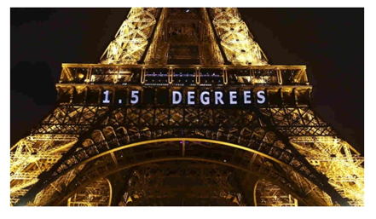
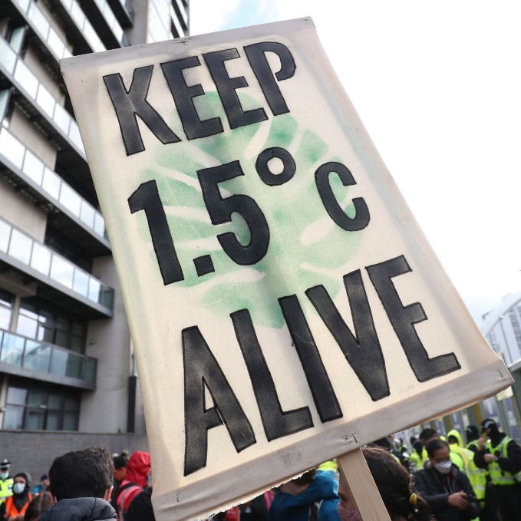
International Climate Action
Paris Agreement (COP 21, 2015)
Legally binding international treaty on climate change.
Aims to limit global warming to well below 2, preferably to 1.5ºC, compared to pre-industrial levels.
Landmark agreement - brings all nations into a common cause to undertake ambitious efforts to combat climate change and adapt to its effects.
Glasgow Climate Pact (COP 26, 2021)
Aims to turn the 2020s into a decade of climate action and support.
Nations are called upon to phase down unabated coal power and inefficient subsidies for fossil fuels.
At least 90% of the global economy is covered by net zero carbon commitments, up from 30% when the UK took on the COP presidency in 2019.
Notes:
The United National Framework Convention on Climate Change (UNFCCC) was created in 1992 as the main forum for international action on climate change.
In 2015, Parties to the UNFCCC reached a landmark agreement – The Paris Agreement – to combat climate change and accelerate the actions and investments needed for a sustainable low carbon future.
The goal of the Paris Agreement is to limit global warming to well below 2, preferably to 1.5ºC, compared to pre-industrial levels.
At COP 26 – in 2021 – nations adopted the Glasgow Climate Pact, aiming to turn the 2020s into a decade of climate action and support.
For the first time, nations are called upon to phase down unabated coal power and inefficient subsidies for fossil fuels.
At least 90% of the global economy is now covered by net zero carbon commitments, up from 30% when the UK took on the COP presidency in 2019,

Slide 11
International Climate Action
This film aims to demonstrate the urgent climate action that world leaders need to take in reducing global carbon emissions, the benefits of reducing carbon and how this would result in a positive impact worldwide.
In the video Toronto city is used as a real-life scaling landscape to show the rate of global carbon emissions in real time.
Please click to watch:
https://youtu.be/10T2iDOjc4E

Slide 12
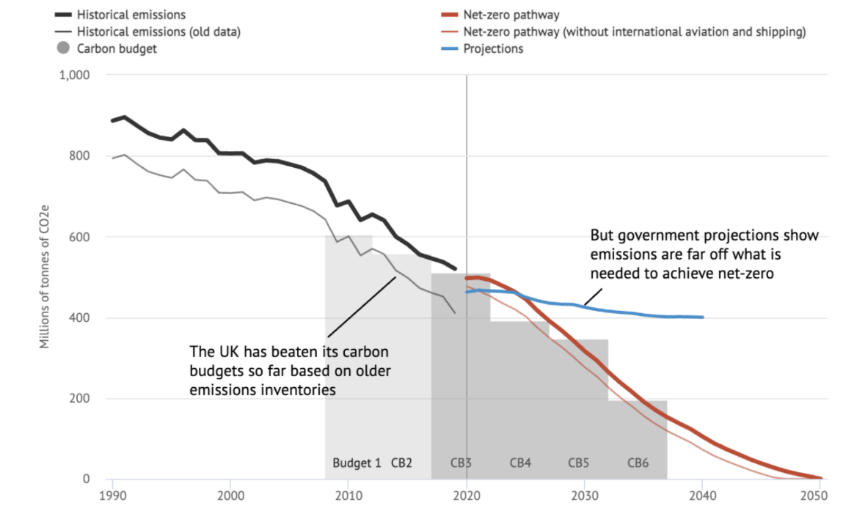
UK Climate Action
Notes:
As a signatory to the Paris Agreement, the UK has committed to contribute to global emission reductions to limit global temperature rise to well below 2°C and to pursue efforts towards 1.5°C above pre-industrial levels.
The Climate Change Act is the basis for the UK’s approach to tackling and responding to climate change.
Through the Climate Change Act, the UK government has committed to reduce emissions by at least 100% of 1990 levels (to net zero) by 2050.
The Climate Change Act requires the government to set legally-binding ‘carbon budgets’ to act as stepping stones towards the 2050 target. A carbon budget is a cap on the amount of greenhouse gases emitted in the UK over a five-year period.
The budgets describe the cost-effective pathway to achieving the UK’s long-term climate change objectives
The first and second carbon budgets were achieved, and the UK is on track to outperform the third.
However, the UK is not on track to meet the fourth, fifth or sixth carbon budgets.
In October 2021 government published its Net Zero Strategy which sets out policies and proposals for decarbonising all sectors of the UK economy to meet the net zero target by 2050.
You can access the Net Zero Strategy by clicking on the document.

Slide 13
Reaching net-zero in the UK
Reaching net-zero greenhouse gas emissions requires extensive changes across the economy, but the foundations are in place. Major infrastructure decisions need to be made in the near future and quickly implemented. These changes are unprecedented in their overall scale, but large-scale transitions have been achieved successfully in the UK before, such as the natural gas switchover in the 1970s or the switch to digital broadcasting in the 2000s.
What changes are needed?
Resource and energy efficiency, that reduce demand for energy across the economy
Societal choices that lead to a lower demand for carbon-intensive activities
Extensive electrification, particularly of transport and heating, supported by a major expansion of renewable and other low-carbon power generation
Development of a hydrogen economy to service demands for some industrial processes, for energy-dense applications in long-distance HGVs and ships, and for electricity and heating in peak periods
Carbon capture and storage (CCS) in industry, with bioenergy (for GHG removal from the atmosphere), and very likely for hydrogen and electricity production.
Follow this link for the latest information on the accelerating momentum for net zero carbon globally and to see which countries are leading the net zero race.
https://eciu.net/netzerotracker

Slide 14
Local action on Climate Change
The UK's contribution to climate change under the net zero target requires urgent ambitious action across all sectors of the UK economy.
Please click through the next few slides to learn more about local climate action:

Slide 15
Transport

Slide 16
Decarbonising transport
Decarbonising transport: a better, greener Britain
Notes:
Transport has a huge role to play in the economy, reaching net zero. The scale of the challenge demands a step change in both the breadth and scale of ambition.
UK Government has published it’s Transport Decarbonisation Plan which identifies 6 strategic priorities. The strategic priorities reflect the themes and view of the future that will be pursued to decarbonise the UK’s transport system before 2050.
HS2 supports each of the 6 strategic priorities, particularly priorities 1 – accelerating modal shift to public and active transport – and 2 – decarbonisaing how we get our goods.
HS2 will be a critical part of a net zero carbon transport network. It will deliver zero carbon journeys to hundreds of thousands of people every day and will contribute to the decarbonisation of the wider transport system – through modal shift of passenger and freight journeys from road and air to rail.
You can read the Transport Decarbonisation Plan in full by clicking on the box.

Slide 17
Power

Slide 18
Power
National Grid ESO is preparing GB's electricity system to be able to run purely on 0 carbon electricity by 2025, whilst at the same time keeping the lights on for homes and businesses 24/7.
Watch the video to find out what they're doing, to enable the grid to run with zero carbon emissions by 2025.
https://youtu.be/MrIRWETN2eI

Slide 19
Infrastructure and Construction

Slide 20
Decarbonising infrastructure & construction
Options for reducing emissions:
Resource efficiency
Material substitution
Energy efficiency
Fuel-switching
Carbon capture and storage (CCS)
UK emissions
Element grouping
Notes:
Greenhouse gas emissions from manufacturing and construction were 66 MtCO₂e in 2018, 12% of the UK total.
The largest source of emissions was iron and steel production, accounting for almost 20% of manufacturing and construction emissions.
Cement and lime production accounted for around 12% of emissions.
7% of emissions were associated with off-road mobile machinery for construction where emissions come from the combustion of diesel, which is used as a fuel.
There are a number of ways to reduce emissions from manufacturing and construction in the UK.
Resource efficiency – reducing the flow of materials through the economy and using products more efficiently – and for longer – can reduce manufacturing emissions, as part of a shift towards a more circular economy.
Material substitution can reduce manufacturing emissions by switching from high carbon materials to lower carbon materials. For example, using wood in construction and using cement replacements.
Using energy more efficiently reduces operating costs while cutting emissions. Measures include process and equipment upgrades, installing or improving heat recovery systems, and clustering with other sites and businesses to efficiently utilise waste heat and other by-products.
Hydrogen, electricity and bioenergy can all be used to meet heat, motion and electrical demands, thus replacing the use of fossil fuels and reducing greenhouse gas emissions.
Carbon Capture and Storage can be used to capture carbon dioxide produced by larger industrial point-sources, and transport it to a carbon dioxide storage site, thus reducing emissions to the atmosphere. Carbon Capture and Storage is particularly important in the manufacturing sector, as it can abate emissions that cannot be addressed simply by switching to low- or zero-carbon energy. For example, emissions from chemical reactions – such as the calcination of limestone in cement production.

Slide 21
Infrastructure and Construction
Please find the video links below to other useful resources:
Terri Wills, CEO, World Green Building Council (WGBC), talks about the possible solutions to reducing carbon emission in construction.
Mike Putnam, President & CEO of Skanska UK, talks about what has to be done to reduce carbon in infrastructure projects.
More videos can be accessed at Construction Climate Talks – YouTube

Slide 22
Cities and Regions

Slide 23
Cities and Regions
Cities can help achieve net-zero by supporting the implementation of transformational actions to increase the supply of renewable energy, improve building energy efficiency, increase access to affordable, low carbon transport options, and change consumption patterns.
Cities and regions across the UK are taking action to tackle climate change and are already leading the way with ambitious plans to accelerate action on climate change:
Nottingham aims to achieve net zero carbon emissions by 2028.
Bournemouth, Bristol, Edinburgh, Greater London, Leicester, Liverpool and Newcastle have committed to delivering net-zero carbon city-regions by 2030.
Greater Manchester Combined Authority aims to achieve net zero carbon emissions by 2038
The West Midlands Combined Authority aims to achieve net zero carbon emissions by 2041.

Slide 24
Summary of Module 4:
There are significant economic, social and environmental benefits of taking climate action.
The UK became the first major economy in the world to pass laws to end its contribution to global warming by 2050. However, the UK is not on track to achieve its fourth, fifth or sixth carbon budgets and is far from the net-zero trajectory.
There is growing momentum behind net zero targets, but urgent ambitious action is needed.
Leadership, collaboration and innovation are crucial enablers to bring greenhouse gas emissions to net-zero by 2050.

Slide 25
Multiple choice questions
Select the correct answer to the below question:
The overall goal of the Paris Agreement is to limit warming to no more than?
1.5ºC
2ºC
2.5ºC
3ºC
Answer:
1.5ºC
The overall objective of the Paris Agreement is to limit warming to no more than 1.5ºC, compared to pre-industrial levels.

Slide 26
Multiple choice questions
Select the correct answer to the below question:
The UK has set a goal to have net zero greenhouse gas emissions by?
2050
2040
2030
2060
Answer:
2050
The UK has set a goal to have Net Zero greenhouse gas emissions by 2050.

Slide 27
True or False
Is the below statement True or False?
Accelerating modal shift to public and active transport is one of the six strategic priorities for the Government’s Transport Decarbonisation Plan.
Answer:
True
True
False

Slide 28
Congratulations
You have now completed Module 4 of the HS2 Carbon Literacy Certificate training.
Please continue with Module 5.

