Slide 1
Carbon Literacy Certificate Training
Module Three

Slide 2
Summary of Module 2:
Please watch this short video to refresh your knowledge:
https://youtu.be/9MtSN_MsXAU

Slide 3
Impacts of Climate Change

Slide 4
What you will learn in this section:
How climate worldwide is likely to change
How changes in the climate are likely to affect us:
Globally
Nationally (UK)
Locally

Slide 5
How climate is likely to change Worldwide
https://www.theccc.org.uk/publication/net-zero-the-uks-contribution-to-stopping-global-warming/
Notes:
Climate change is already having visible effects on the world. The Earth is warming, rainfall patterns are changing, and sea levels are rising. These changes can increase the risk of heatwaves, floods, droughts, and fires.
The level of climate change we will see depends on how quickly we cut greenhouse gas emissions. Even if we were to stop all emissions today, we would not prevent some changes. However, the sooner we cut emissions, the smaller the changes will be.

Slide 6
What happens if the world warms up
Click here to find out
Click here to find out
https://www.theccc.org.uk/publication/net-zero-the-uks-contribution-to-stopping-global-warming/

Slide 7
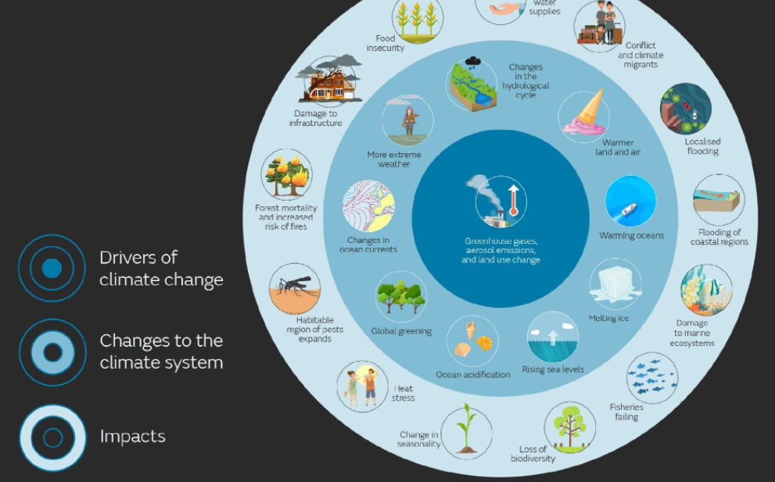
Effects of Climate Change
This image summarises some of the drivers of climate change and the impacts they could have on the climate system.
https://www.metoffice.gov.uk/weather/climate-change/effects-of-climate-change

Slide 8
Economic impact of Climate Change in Europe
Please click to watch this short video:
https://youtu.be/Y1RGyfQplo0

Slide 9
How climate change affects human health
Direct impacts
Indirect impacts through natural systems
Indirect impacts through socio-economic systems
Notes:
Climate change is the biggest global health threat of the 21st century.
Health is and will be affected by the changing climate through direct impacts, such as heat waves, droughts, heavy storms, and sea-level rise; and, indirect impacts, such as vector-borne and airways diseases, food and water insecurity, undernutrition, and forced displacements.

Slide 10
Which countries are responsible for Climate Change?
Analysis: Which countries are historically responsible for climate change? - Carbon Brief
Notes:
Historical responsibility for climate change is at the heart of debates over climate justice.
History matters because the cumulative amount of carbon dioxide emitted since the start of the industrial revolution is closely tied to the 1.2ºC of warming that has already occurred.
In total, humans have pumped around 2,500 billion tonnes of carbon dioxide into the atmosphere since 1850, leaving less than 500 billion tonnes of carbon dioxide of remaining carbon budget to stay below 1.5ºC of warming.
This animation shows, by ranked nation, cumulative carbon dioxide emissions from fossil fuels, land use and forestry from 1850 to 2021.
The remaining carbon budget to limit global warming at 1.5C is shown in the bottom right.

Slide 11
How will Climate Change impact different parts of the world
The following slides will look at:
Food production at risk in Sub Saharan Africa
Coastal zones and cities at risk in Southeast Asia
Increased scarcity and access to water in South Asia.
Please click the link to view the full at World Bank Infographic, which seeks to highlight the disparities about climate change impacts different geographical locations:
https://www.worldbank.org/en/news/feature/2013/06/19/Infographic-Climate-Change-in-Sub-Saharan-Africa-South-Asia-South-East-Asia

Slide 12
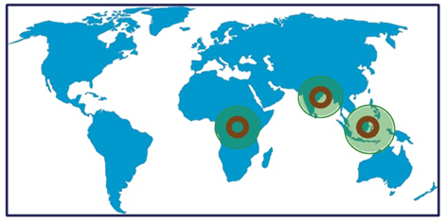
Equity and Fairness
Please click through the next few slides to learn more about how will climate change impacts different parts of the world:

Slide 13
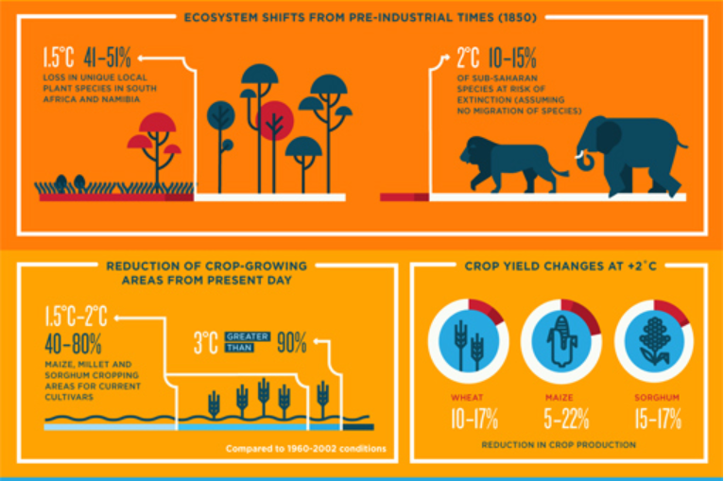
Food Production: Sub-Saharan Africa
Under warming of about 1.8-2⁰c,
climate change could indirectly cause Malnutrition in an additional 10 million by 2050.
https://www.worldbank.org/en/news/feature/2013/06/19/Infographic-Climate-Change-in-Sub-Saharan-Africa-South-Asia-South-East-Asia

Slide 14
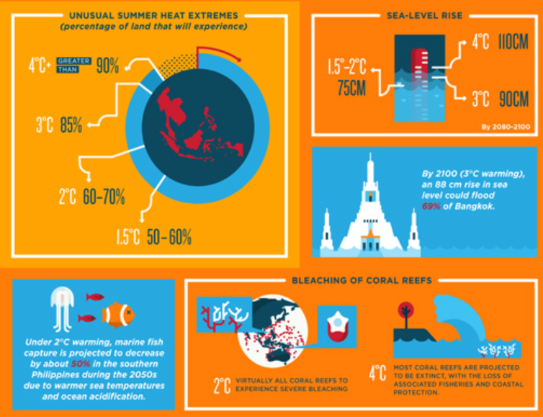
Coastal Zones and cities at risk
https://www.worldbank.org/en/news/feature/2013/06/19/Infographic-Climate-Change-in-Sub-Saharan-Africa-South-Asia-South-East-Asia

Slide 15
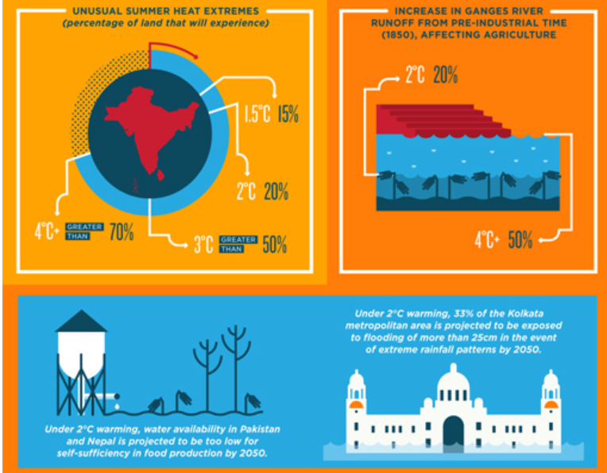
Increased scarcity and access to water
Extreme wet monsoons that currently have a chance of occurring only once I 100 years are projected to occur every 10 years by the end of the century.
https://www.worldbank.org/en/news/feature/2013/06/19/Infographic-Climate-Change-in-Sub-Saharan-Africa-South-Asia-South-East-Asia

Slide 16
Equity and Fairness Cont.
Climate change impacts the poorest more than the wealthy.
The world’s richest 10% of people cause 50% of emissions.
The world’s poorest 50% of people contribute approximately 10% of global emissions.
The average person in the UK emits 65 times more carbon compared to someone in Malawi.
Climate justice means balancing the scales.
Notes:
Climate change effects are not being felt equally around the world.
Climate change impacts the poorest more than the wealthy.
Climate justice means repairing the damage to these people’s lives but also holding those most responsible for the climate crisis to account.
Research by Oxfam shows that the world’s richest 10% of people cause 50% of emissions.
The world’s poorest 50% of people contribute approximately 10% of global emissions.
Data from the World Bank show that the average person in the UK emits 65 times more carbon compared to someone in Malawi.
US, Canadian and Australian citizens emit over 150 times more.
Climate justice will balance the scales.
Repairing the consequences of climate change is crucial. But, it is not enough. Climate justice also means transitioning away from the system that has got us here so that we can try to limit warming below 1.5°.

Slide 17
State of the UK climate in 2020
What will climate change look like near me?
Notes:
The UK's climate is changing. Recent decades have been warmer, wetter and sunnier than the 20th century.
2020 was the third warmest, fifth wettest and eighth sunniest on record for the UK. No other year has fallen in the top-10 for all three variables for the UK.
You can learn more about what climate change will look like near you by clicking on the blue box.

Slide 18
Summary of Module 3:
Climate change is already having visible effects on the world. The Earth is warming, rainfall patterns are changing, and sea levels are rising. These changes can increase the risk of heatwaves, floods, droughts, and fires.
The level of climate change we will see depends on how quickly we cut greenhouse gas emissions. Even if we were to stop all emissions today, we would not prevent some changes. However, the sooner we cut emissions, the smaller the changes will be.
Limiting warming to 1.5ºC would avoid the most damaging effects of climate change.
Though developed countries produce most greenhouse gas emissions, developing countries are predicted to see most of the severe effects. With fewer resources to adapt to these changes, the impact on people in developing countries is expected to be higher.
The effects of climate change are already being felt in the UK. Average temperatures are increasing and there is a trend towards milder winters and hotter summers. We can also expect more frequent floods.

Slide 19
True or False
Is the below statement True or False?
In just a 2⁰C hotter world, more than 388 million people could be exposed to water scarcity.
Answer:
True
True
False

Slide 20
True or False
Is the below statement True or False?
The impacts of Climate Change will be felt at the same magnitude in all parts of the world.
Answer:
False
True
False

Slide 21
True or False
Is the below statement True or False?
Climate Change will increase the risk of more severe and widespread flooding in the UK.
Answer:
True
True
False

Slide 22
True or False
Is the below statement True or False?
The UK is projected to experience temperature increases of up to ~3⁰C in the south.
Answer:
True
True
False

Slide 23
Congratulations
You have now completed Module 3 of the HS2 Carbon Literacy Certificate training.
Please continue with Module 4.

