Slide 1
Carbon Literacy Certificate Training
Module Two

Slide 2
Climate Change and the climate impact of human activities

Slide 3
Summary of Module 1:
Please watch this short video to refresh your knowledge:
Click Here
https://www.itv.com/footprint/climate-change-the-facts.html

Slide 4
What you will learn in this section:
How we know that Earth’s climate has changed throughout history?
How temperature and atmospheric greenhouse gas levels have changed in the past.
How we can relate recent changes to human activity.
How human activities impact atmospheric greenhouse gas levels and thus climate and weather.

Slide 5
Earths climate has changed throughout history. But how do we know this without direct measurement?
Palaeoclimatology is the study of past climates. Temperatures and atmospheric carbon dioxide levels can be reconstructed from a number of preserved physical characterises of the past as a proxy for direct meteorological measurements:
Please click through the next few slides to learn more about:

Slide 6
Ice Cores
Ice Cores are cylindrical samples taken by drilling into ice sheets in Greenland, Antarctic and North American regions.
The ice cores contain tiny air bubbles trapped in the snow, as the snow compacts over thousands of years into thick ice.
The air in the bubbles therefore gives a direct measurement of prehistoric atmospheric air.
Therefore, CO₂ concentrations can be reconstructed through time.
Ice cores can reveal climate records going back 800,000 years.

Slide 7
Tree Rings
Trees grow over large geographical areas and with their annual growth rings, this makes them a good proxy.
They can provide climate information from the present day up to a few 100 years.
In good growth conditions, rings grow more rapidly.
We can therefore reconstruct warm season and annual average temperatures from the records.
However, they can only provide land-based records, and climate signals must be separated from biological ones.

Slide 8
Corals
Corals provide a similar sort of proxy to tree rings, but through growth bands in there exoskeleton.
This exoskeleton is made of calcium carbonate.
In cooler waters, heavier isotopes of oxygen are more prevalent in the growth bands.
In warmer waters, less heavy isotopes of oxygen are more prevalent.
By dating the coral analysis of the chemical composition of the growth rings will provide an indication of the temperature of the water in which the coral lived.
Because corals live in the ocean, the data they provide are a crucially important addition to the land-based data available from tree rings.
Corals can provide records for up to a few 1000 years.

Slide 9
Lake Sediment (Varves)
Lake varves are deposited in very fine layers of different sediments at the bottom of lakes.
The rate and type of sediment being deposited is influenced by climate variations.
Varve features can determine summer temperatures, winter snowfall and rainfall up to a few 1000 years.
They can therefore determine past temperatures, as well as patterns of precipitation and drought.

Slide 10
Cave Deposits (Speleothems)
Cave deposits such as stalagmites and stalactites, are formed by the deposition of minerals from dripping Cave Water.
Their simple geometry and sheltered location means that cave deposits can provide land-based records for up to 500,000 years.
Through their chemical composition and formation, they can provide information on:
Temperatures
Precipitation changes
Vegetation changes.

Slide 11
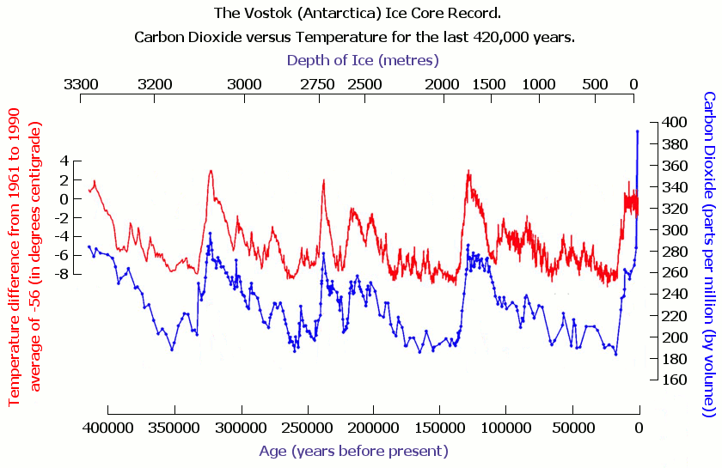
How temperature and atmospheric greenhouse gas levels have changed in the past
Climate proxies, as explored in previous slides, allow scientists to reconstruct CO₂ concentrations over long periods of time and track changes.
Notes:
Earths climate has changed throughout history.
We know this through Palaeoclimatology – the study of past climates. Temperatures and atmospheric carbon dioxide levels can be reconstructed using, for example, ice cores, tree rings and lake sediments.
The data presented in this graph is derived from air bubbles of gas trapped in layers of the ice sheets of Greenland and Antarctica, and isotopes of oxygen in the ice cores that are temperature markers.
As can be seen in the graph, global average temperature in red and carbon dioxide concentrations in blue varied widely and in unison over Earth’s history.
Several factors have affected past climate change, including very small variations in Earth's orbit that change the amount of solar energy our planet receives, volcanic activity and changes in the composition of the atmosphere.
Carbon dioxide levels have increased dramatically and rapidly in recent centuries. The annual rate of increasing atmospheric carbon dioxide over the past 60 years is about 100 times faster than previous natural increases.
Today, carbon dioxide levels exceed 400 parts per million. This is higher than at any point in at least the past 800,000 years.
For millennia, carbon dioxide levels did not exceed 300 parts per million.
In fact, the last time carbon dioxide levels were this high was more than 3,000,000 years ago when temperature was 2-3 degrees higher than during the pre industrial era and sea level was 15 to 25 meters higher than today.
Direct measurements of atmospheric carbon dioxide levels have been available since the 1950’s.
Please click ‘next’ to watch a short video to learn more.

Slide 12
The ‘Keeling Curve’
https://www.youtube.com/watch?v=Z43FQCSg4Ow

Slide 13
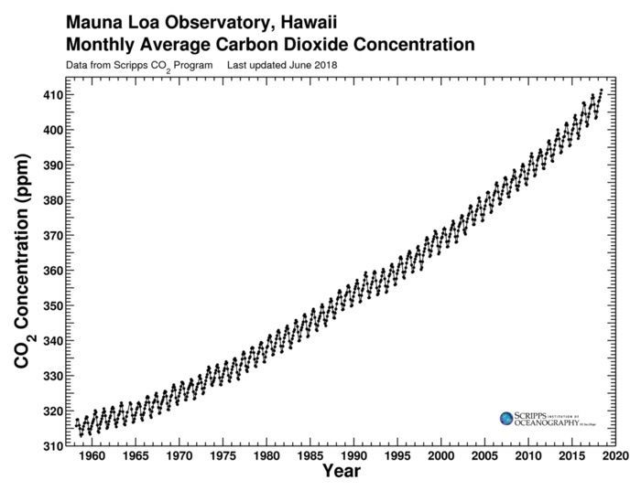
The ‘Keeling Curve’
Notes:
The Keeling Curve is the first significant evidence of rapidly increasing carbon dioxide levels in the atmosphere.
Keeling is often credited with first bringing to the world's attention the effect that human activities have on the Earth's atmosphere and climate.
The atmospheric carbon dioxide concentration prior to the Industrial Revolution was stable, about 280 parts per million. By 1958, the carbon dioxide concentration was 315 parts per million and accelerating.
In 2019, it exceeded 415 parts per million, almost 50% higher than levels before the Industrial Revolution.

Slide 14
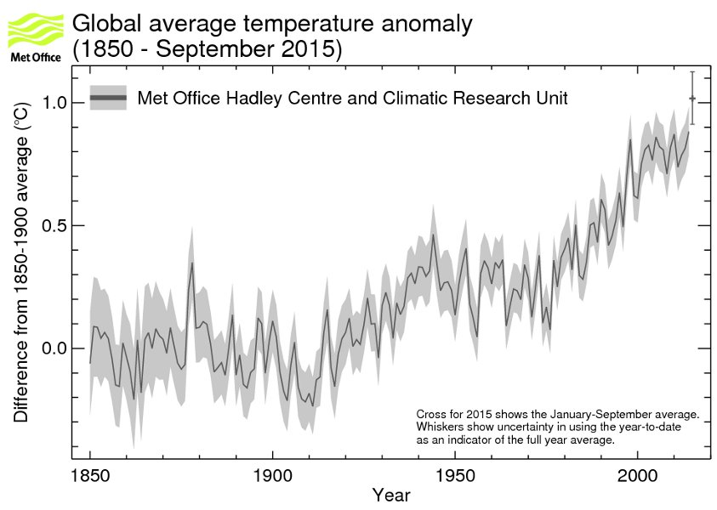
Global average temperature
Notes:
Global annual average surface temperature is now 1 degree Celsius warmer than the pre industrial average. Carbon dioxide concentrations are rising mostly because of the fossil fuels people are burning for energy.
Fossil fuels like coal and oil contain carbon that plants pulled out the atmosphere through photosynthesis over the span of many millions of years, we are returning that carbon to the atmosphere in just a few 100 years.

Slide 15
The leading cause of climate change is…human activity
There is widespread scientific consensus that global warming is happening and that human activity causes it.
“It is unequivocal that human influence has warmed the atmosphere, ocean and land. Widespread and rapid changes in the atmosphere, ocean, cryosphere and biosphere have occurred.”
(Intergovernmental Panel on Climate Change, 2021)
Anthropogenic greenhouse gas emissions have increased since the pre-industrial era, driven largely by economic and population growth and are now higher than ever.
Human activities are extremely likely to have been the dominant cause of the observed warming since the mid 20th century.
Notes:
There is widespread scientific consensus that global warming is happening and that human activity causes it.
In 2021, the Intergovernmental Panel on Climate Change concluded that it is unequivocal that human influence has warmed the atmosphere, ocean and land. Widespread and rapid changes in the atmosphere, ocean, cryosphere and biosphere have occurred.
Anthropogenic greenhouse gas emissions have increased since the pre-industrial era, driven largely by economic and population growth and are now higher than ever.
Human activities are extremely likely to have been the dominant cause of the observed warming since the mid 20th century.
Click ‘next’ to learn about the sources of greenhouse gas emissions.

Slide 16
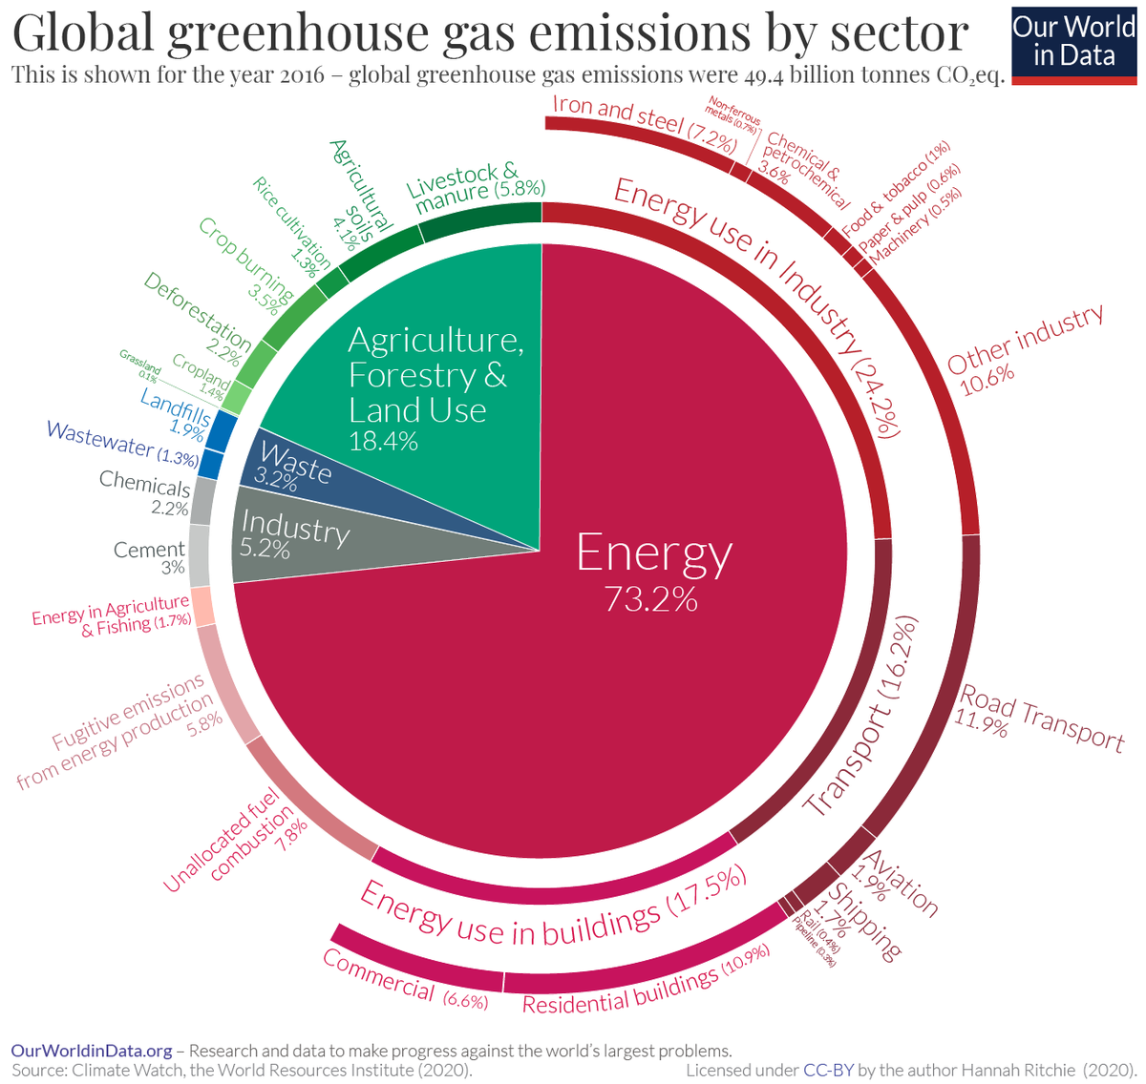
Global greenhouse gas emissions by sector
Shown for the year 2016 – global greenhouse gas emissions were 49.4 billion tonnes of CO₂e
A Global Breakdown of Greenhouse Gas Emissions by Sector (visualcapitalist.com)
Notes:
Global GHG emissions can be roughly traced back to four broad categories: energy, agriculture, industry, and waste.
Almost three-quarters of GHG emissions come from our energy consumption.
Industry-related energy consumption – for example associated with iron and steel manufacture – contributes 24.2% to global emissions.
Transport contributes 16.2%. Within this road contributes almost 12%, aviation almost 2% and rail less than 0.5%.
Energy use in buildings contributes 17.5%.
Please click ‘next’ to learn about UK greenhouse gas emissions.

Slide 17
UK greenhouse gas emissions by sector
Shown for the year 2020 – net territorial emissions were estimated to be 406 million tonnes of CO₂e
2020 UK final greenhouse gas emissions statistics: one page summary (publishing.service.gov.uk)
Notes:
In 2020, 24% of net greenhouse gas emissions in the UK were estimated to be from the transport sector, 21% from energy supply, 18% from business, 16% from the residential sector, 11% from agriculture and 4% from waste management.
The remaining emissions came from Public, Industrial Processes and the Land Use, Land Use Change and Forestry sectors which generated 5% of UK emissions.

Slide 18
UK greenhouse gas emissions by sector
Sector | Main GHG | Main sources
Transport | Carbon dioxide | Petrol and diesel in road transport; particularly passenger cars.
Energy | CO₂ | Natural gas and coal in electricity generation from power stations.
Business |  | Fossil fuel combustion in industry and commerce; and emissions of F gases from the use of fluorinated compounds.
Residential |  | Use of natural gas for heating and cooking.
Agriculture | Methane | Digestive processes of livestock, particularly cattle; and emissions related to the use of fertilisers on agricultural soils.
Waste management |  | The vast majority of these emissions are from landfill sites.
Notes:
The main source of emissions from the transport sector is the use of petrol and diesel in road transport – in particular passenger cars.
Between 1990 and 2020, there has been relatively little overall change in the level of greenhouse gas emissions from the transport sector.
The main source of emissions from the energy sector is the use of natural gas and coal in electricity generation from power stations.
The energy supply sector has historically been the largest emissions sector; however the growth of renewables; together with greater efficiency resulting from improvements in technology, have meant that since 2016 it has been the second largest.
Emissions from the business sector primarily relate to fossil fuel combustion in industry and commerce, although emissions of F gases from the use of fluorinated compounds, for example in refrigeration and air-conditioning, are also significant.
The main source of emissions from the residential sector is the use of natural gas for heating and cooking.
The agriculture sector consists of emissions from livestock, agricultural soils, stationary combustion sources and off-road machinery.
The most significant sources here are emissions of methane due to the digestive processes of livestock, particularly cattle; and nitrous oxide emissions related to the use of fertilisers on agricultural soils.
The waste management sector consists of emissions from waste disposed of to landfill sites, waste incineration, and the treatment of waste-water.
Methane is by far the most prominent gas, accounting for 89% of emissions. The vast majority of these emissions are from landfill sites.

Slide 19
Global greenhouse gas emissions from industry
Industry | Emissions (gigatons of CO₂) | Proportion of total global GHG emissions
Iron & Steel | 3.6 | 7% | Only the annual GHG emissions of China and the U.S. are higher than annual GHG emissions of global steel industry.
Cement | 2.3 | 4.5% | Only the annual GHG emissions of China, U.S. and India are higher than annual GHG emissions of global cement industry.
Aluminium | 0.66 | 2% | If the global aluminum industry represented a country, it would be the 10th largest emitter of annual greenhouse gas emissions in the world.
Notes:
The cement industry is one of the most energy- and carbon-intensive industries.
In 2019, the global cement industry accounted for around 4.5% of total global greenhouse gas emissions.
Only the annual greenhouse gas emissions of China, U.S. and India are higher than annual greenhouse gas emissions of global cement industry.
Iron and steel industry is also one of the most energy intensive and largest contributing industries to global greenhouse gas emissions.
In 2019, the global steel industry accounted for around 7% of total global greenhouse gas emissions.
Only the annual greenhouse gas emissions of China and the U.S. are higher than annual greenhouse gas emissions of global steel industry.
World aluminum production has more than doubled between 2000 and 2020.
In 2019, the global aluminum industry’s energy-related emissions accounted for 2 percent of total global greenhouse gas emissions.
If the global aluminum industry represented a country, it would be the 10th largest emitter of annual greenhouse gas emissions in the world.

Slide 20
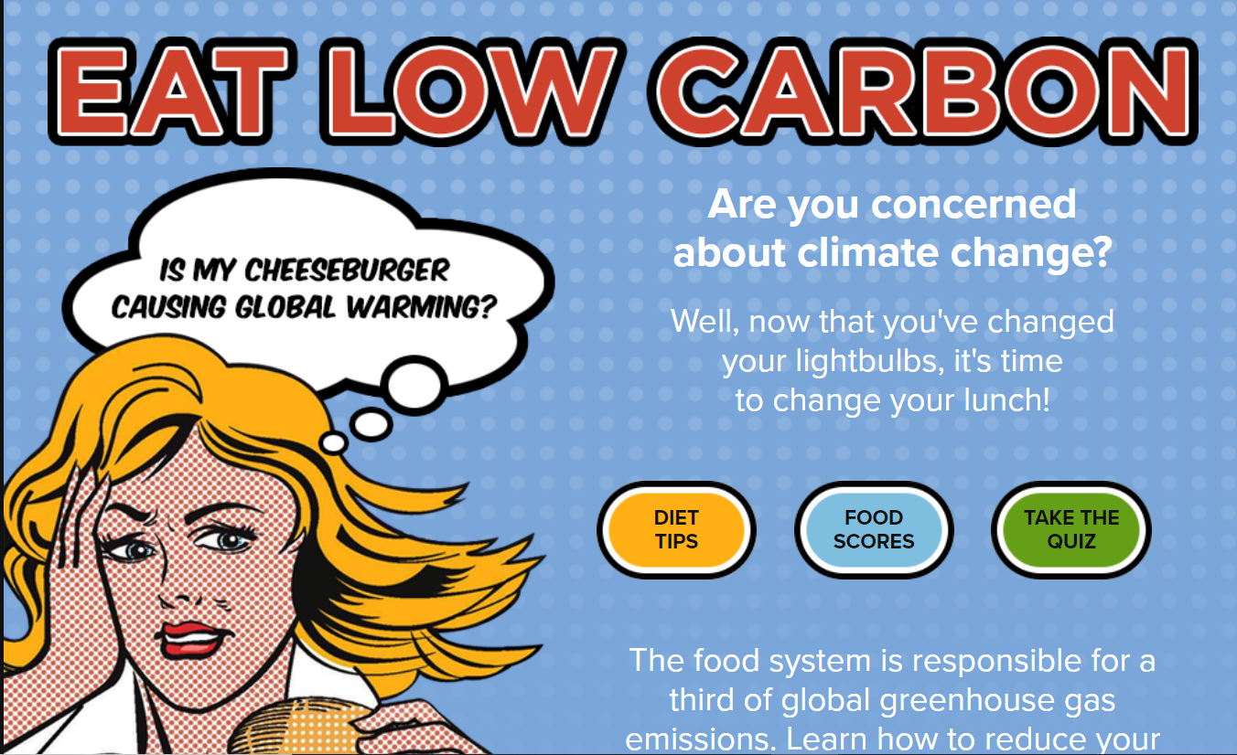
Activity
Do you know how much carbon is in the food you consume?
Complete the 'Eat Low Carbon' activity to find out:
Take Quiz

Slide 21
Summary of Module 2:
Scientists have developed an understanding of the Earth’s climate system through years of observations, theory development and model building.
We know with high confidence that climate change is happening today and human activity such as burning fossil fuels and changing how we use the land, is the leading cause of climate change.
Globally almost three-quarters of greenhouse gas emissions come from energy use; almost one-fifth from agriculture and land use and the remaining 8% from industry and waste.
In 2020, 24% of net greenhouse gas emissions in the UK were estimated to be from the transport sector, 21% from energy supply, 18% from business, 16% from the residential sector, 11% from agriculture and 4% from waste management.
A range of sectors and processes contribute to greenhouse gas emissions. This means there is no single or simple solution to tackle climate change. Action is required across every sector.

Slide 22
Multiple choice questions
Select the correct answer to the below question:
What is the study of past climates called?
Climatology
Geoclimatology
Palaeoclimatology
Earthology
Answer:
Palaeoclimatology

Slide 23
Multiple choice questions
Select the correct answer to the below question:
Today carbon dioxide levels exceed 400 parts per million. The last time carbon dioxide levels were this high was more than 3 million years ago, when temperature was:
2⁰ – 3⁰C lower than during the pre-industrial era.
1⁰ – 2⁰C lower than during the pre-industrial era.
2⁰ – 3⁰C higher than during the pre-industrial era
1⁰ – 2⁰C higher than during the pre-industrial era.
Answer:
2⁰ – 3⁰C higher than during the pre-industrial era

Slide 24
True or False
Is the below statement True or False?
It is extremely likely that human activity has been the dominant cause of the observed warming since the mid-20th century.
Answer:
True
True
False

Slide 25
Multiple choice questions
Select the correct answer to the below question:
In 2018, the transport sector accounted for what proportion of UK greenhouse gas emissions?
Answer:
24%
8%
16%
21%
24%

Slide 26
Multiple choice questions
Select the correct answer to the below question:
Cement production accounts for what proportion of world greenhouse gas emissions?
Answer:
4.5%
1.8%
3%
4.5%
8%

Slide 27
Congratulations
You have now completed Module 2 of the HS2 Carbon Literacy Certificate training.
Please continue with Module 3.

